Slide 1

Projectile Motion Calculator
By: Muhammad Yousuf

Slide 2
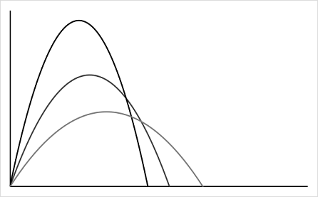
Projectile Motion:
What?
Why & Where?
Theory
Code
?
Projectile motion is the curved path an object follows when thrown or projected into the air, influenced by gravity and air resistance.

Slide 3
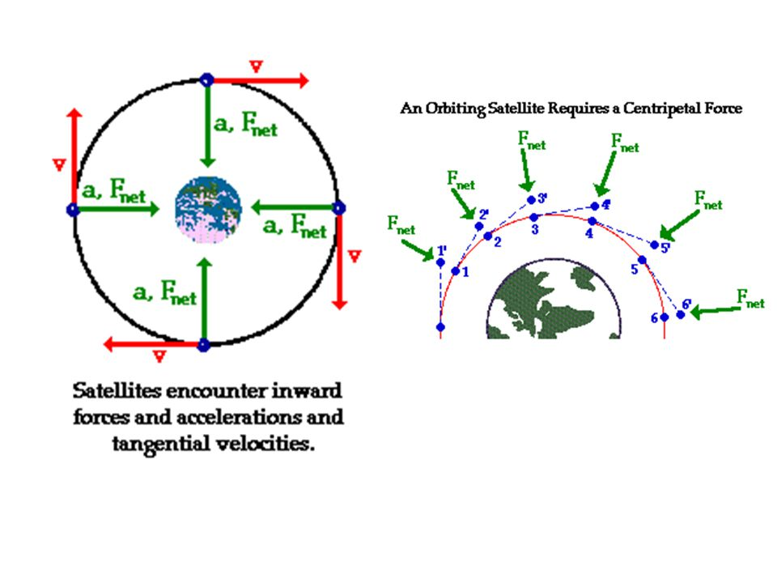
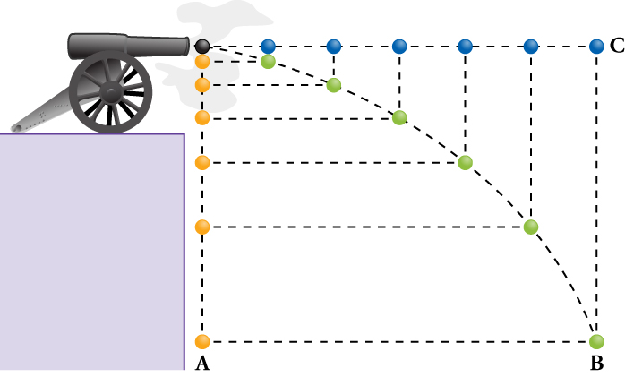
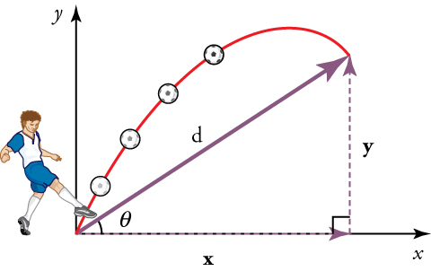
Projectile Motion:
What?
Why & Where? (1)
Theory
Code
?
- Projectile motion is vital in sports, engineering, and physics education.
- Helps predicting the trajectories of a projectile such as spacecraft or orbiting satellites.

Slide 4
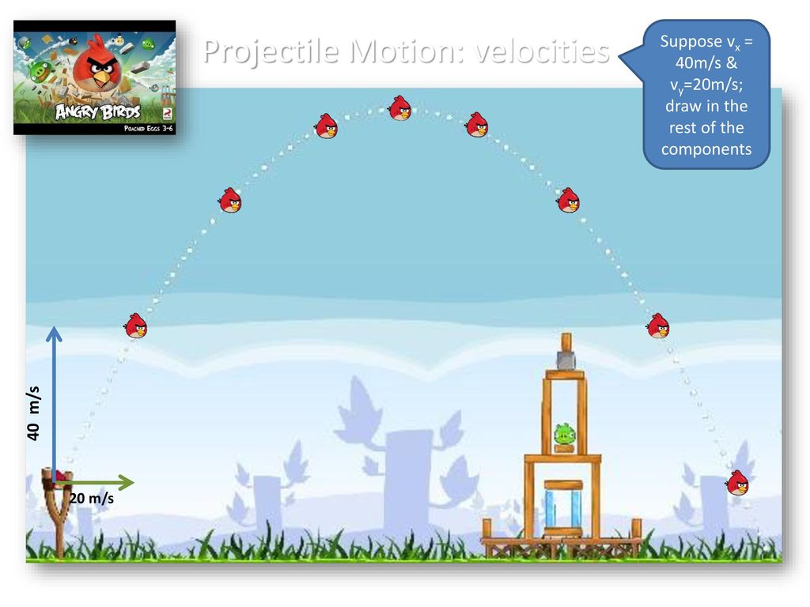
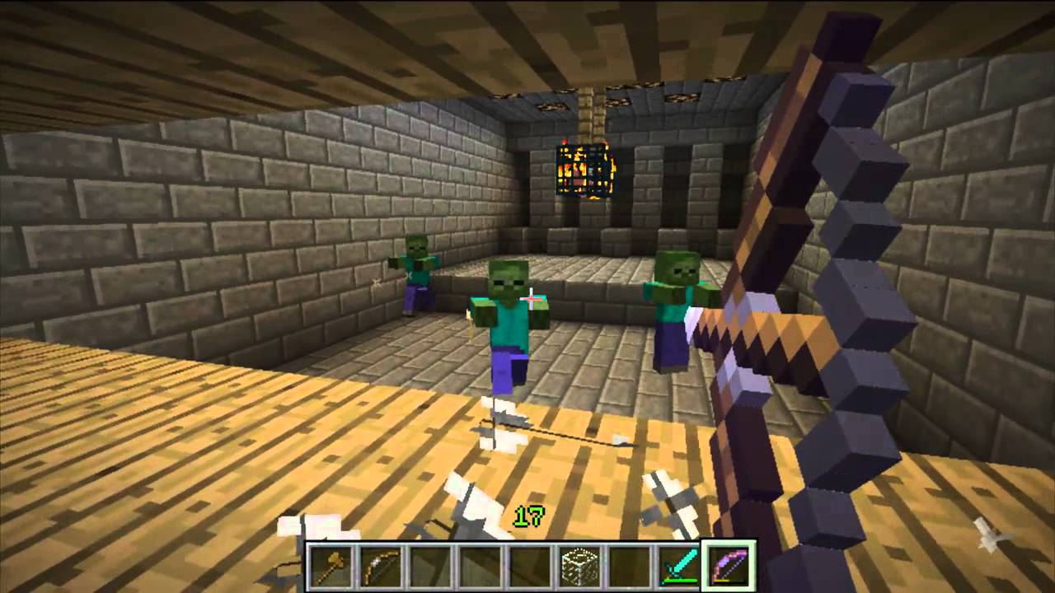

Projectile Motion:
What?
Why & Where? (2)
Theory
Code
?

Slide 5
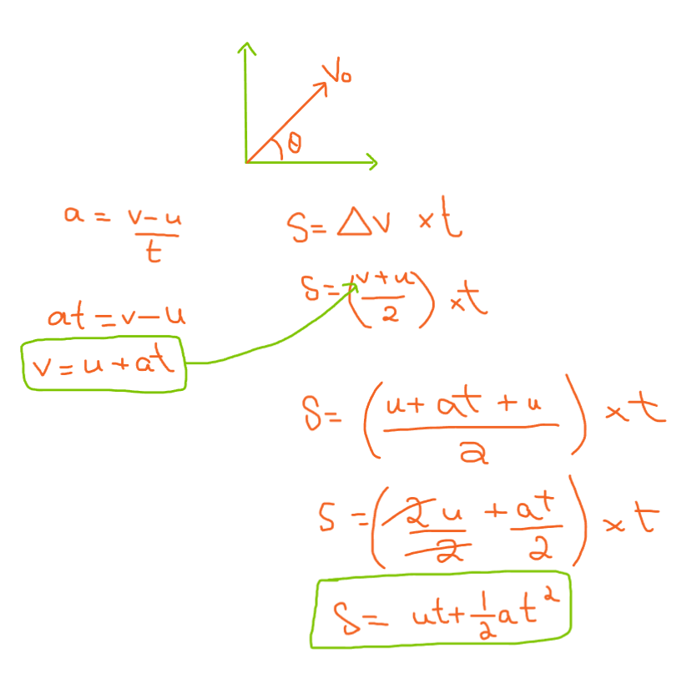
Projectile Motion:
What?
Why & Where?
Theory (1)
Code
?
Deriving the Equation of Motion

Slide 6
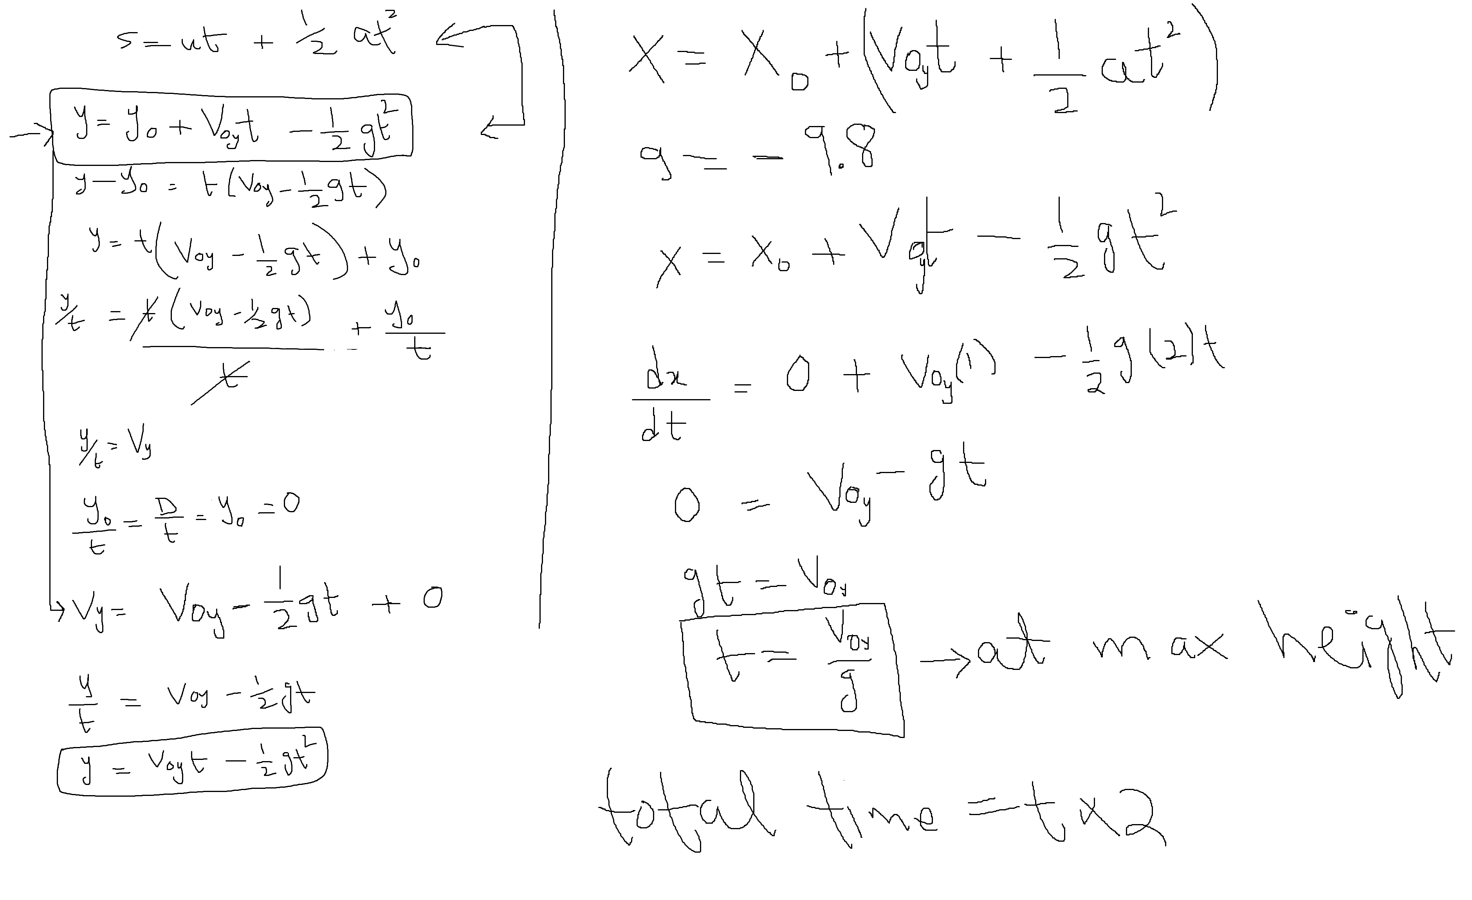
Projectile Motion:
What?
Why & Where?
Theory (2)
Code
?

Slide 7
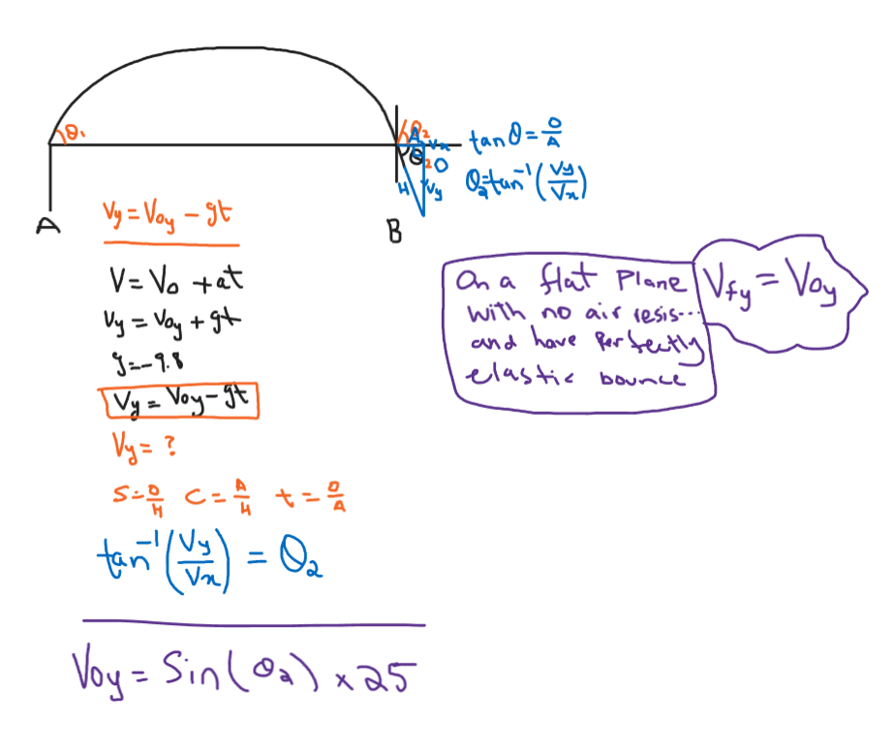
Projectile Motion:
What?
Why & Where?
Theory (3)
Code
?
Bounce trajectory

Slide 8
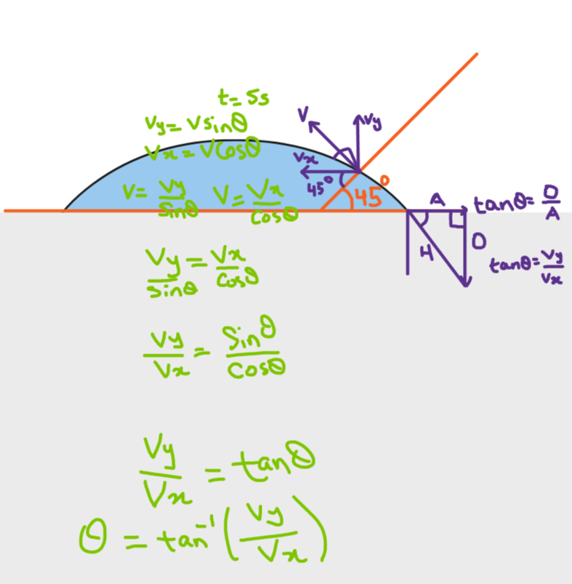
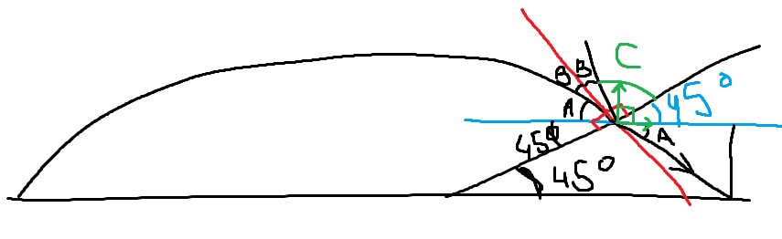
Projectile Motion:
What?
Why & Where?
Theory (4)
Code
?

Slide 9
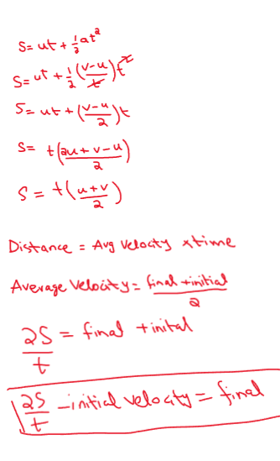
Projectile Motion:
What?
Why & Where?
Theory (5)
Code
?

Slide 10
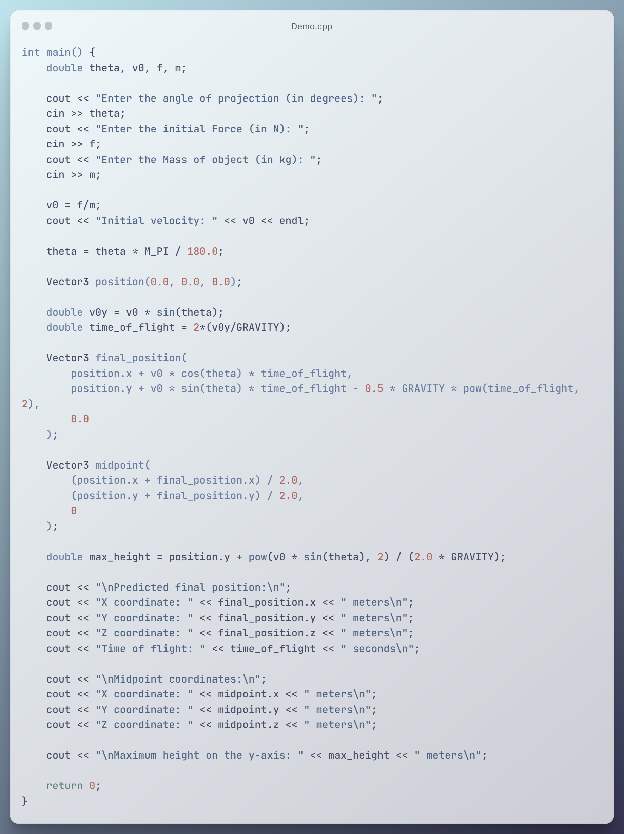
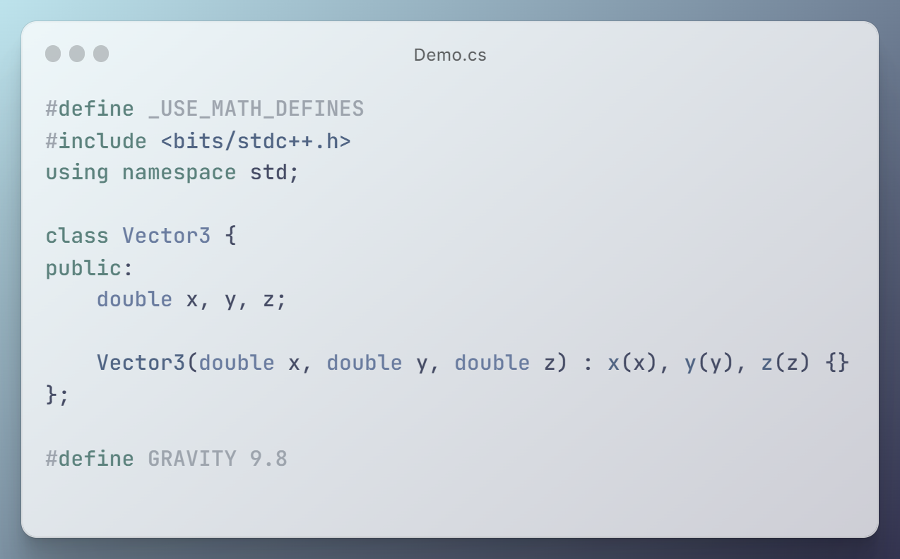
Projectile Motion:
What?
Why & Where?
Theory
Code (1)
?

Slide 11
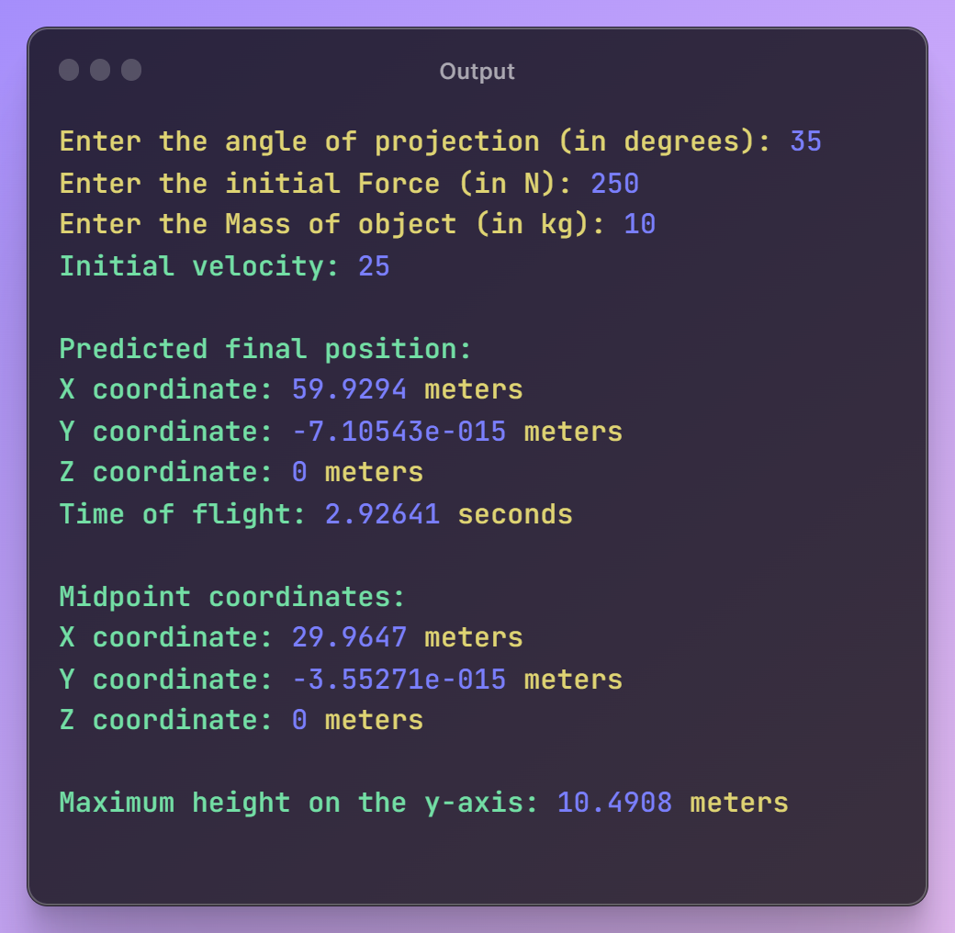
Projectile Motion:
What?
Why & Where?
Theory
Code (1)
?

Slide 12
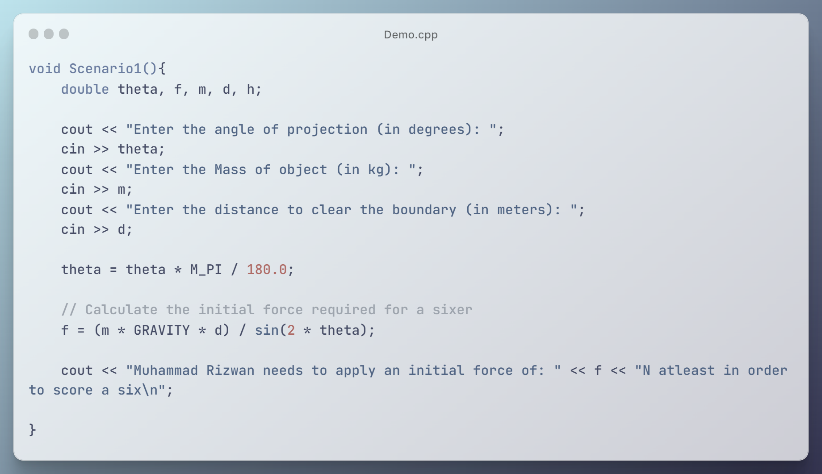
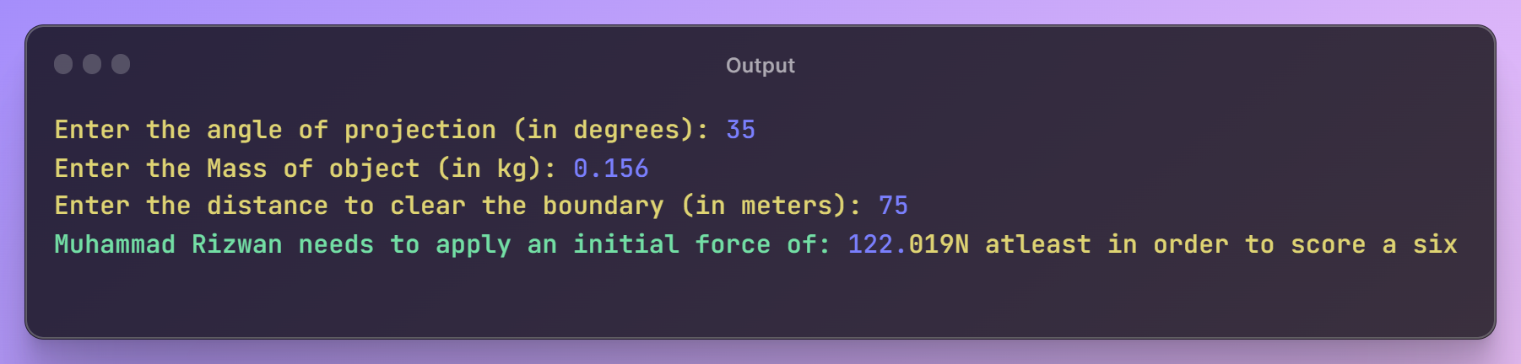
Projectile Motion:
What?
Why & Where?
Theory
Code (1)
?

Slide 13
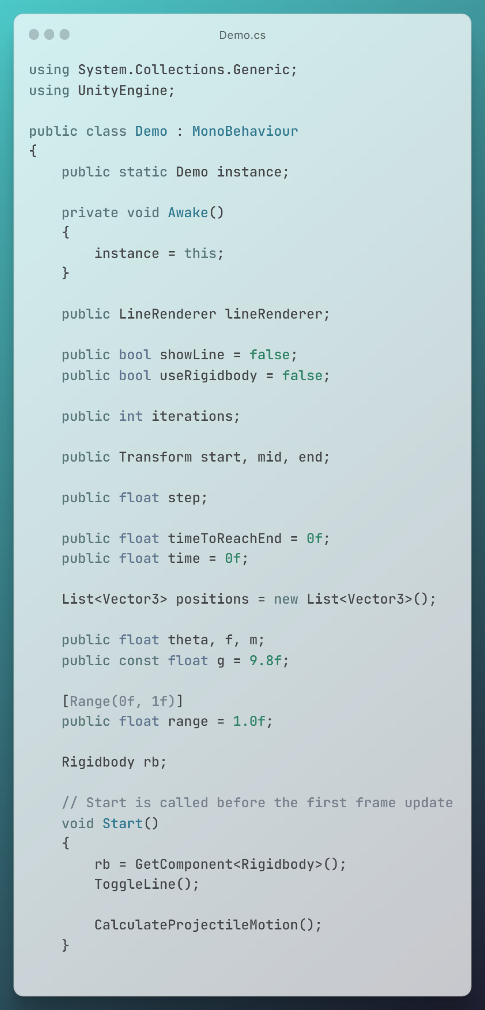
Projectile Motion:
What?
Why & Where?
Theory
Code (2)
?

Slide 14
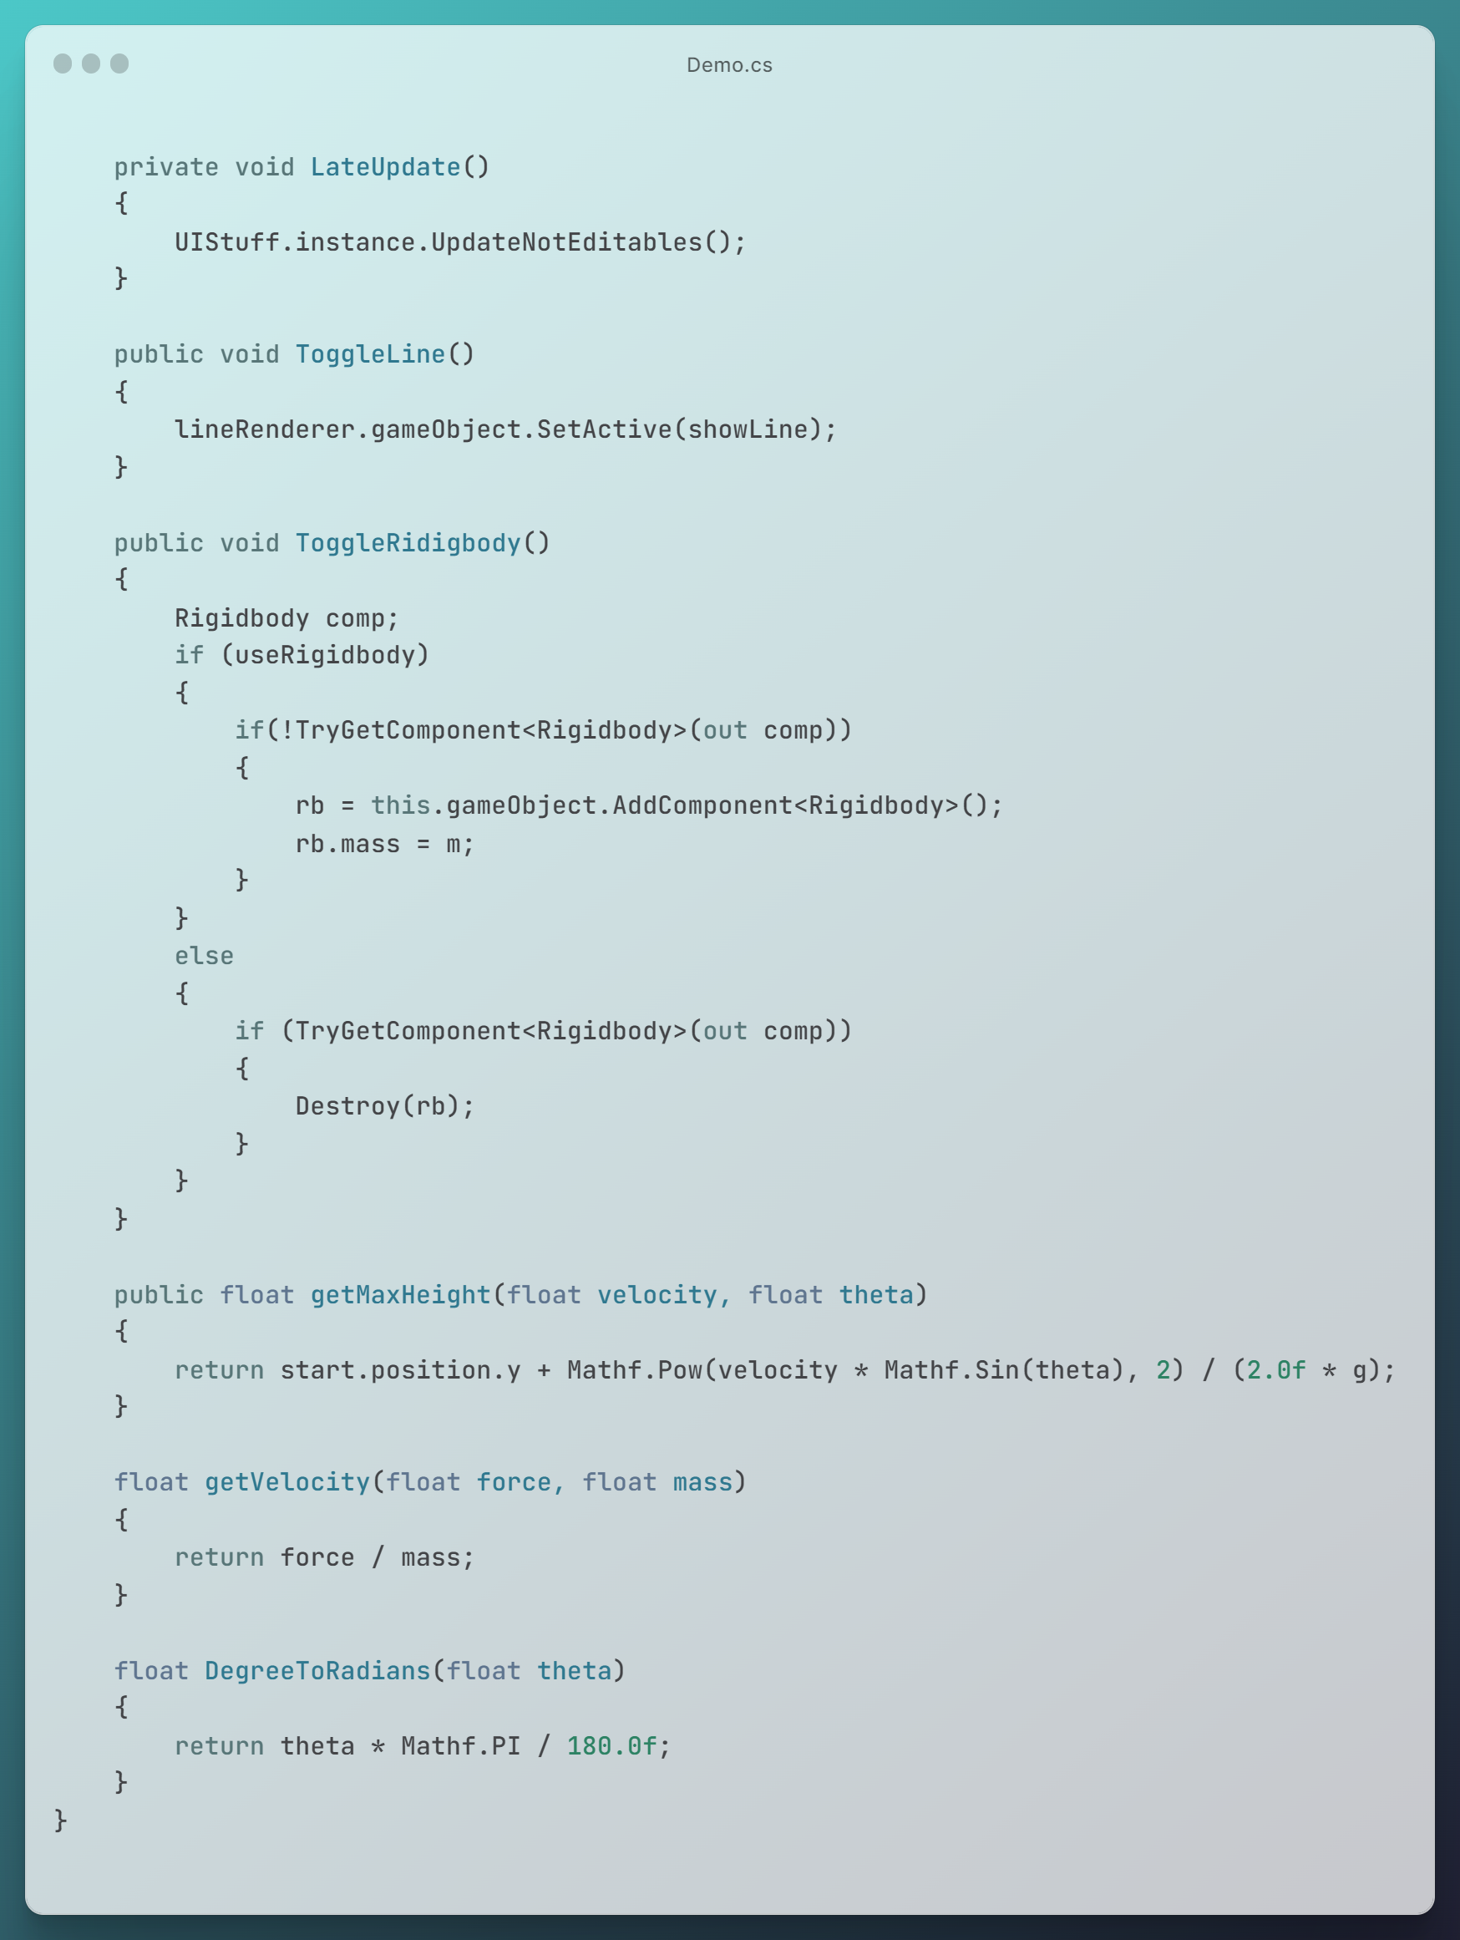
Projectile Motion:
What?
Why & Where?
Theory
Code (2)
?

Slide 15
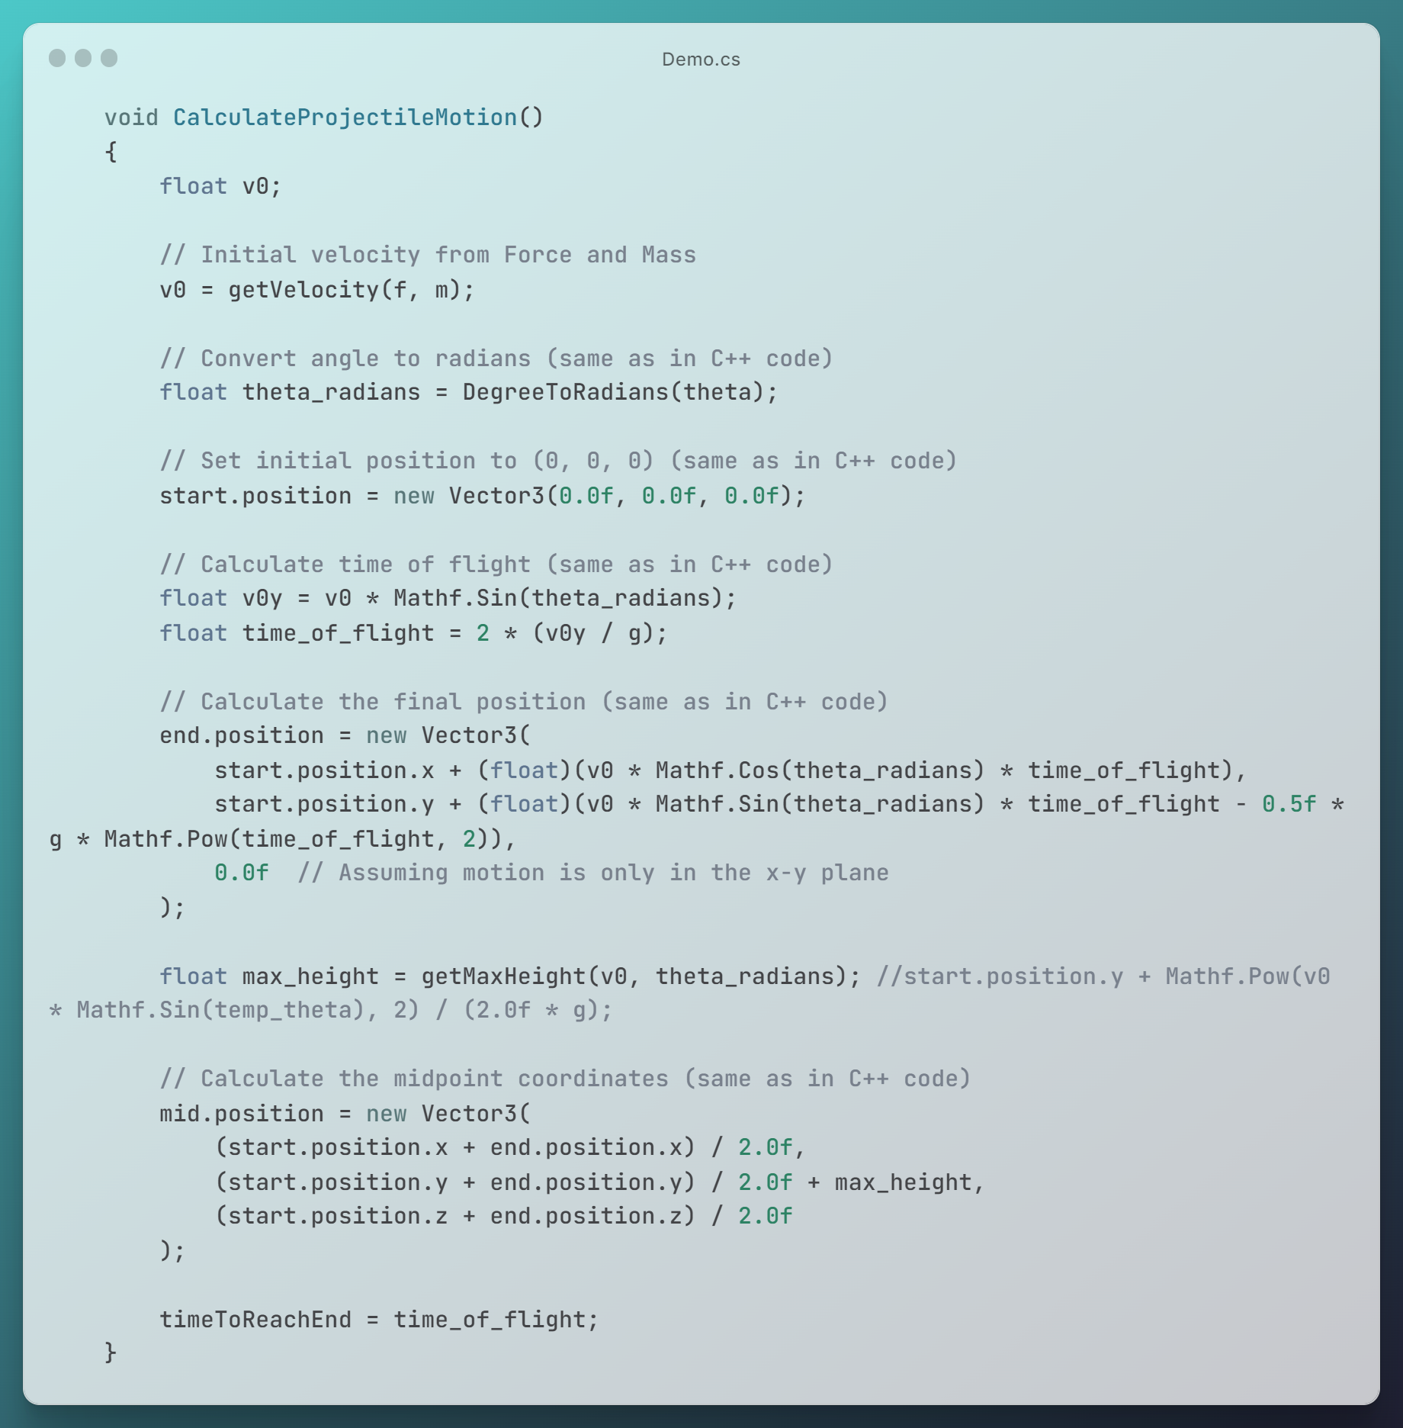
Projectile Motion:
What?
Why & Where?
Theory
Code (2)
?

Slide 16
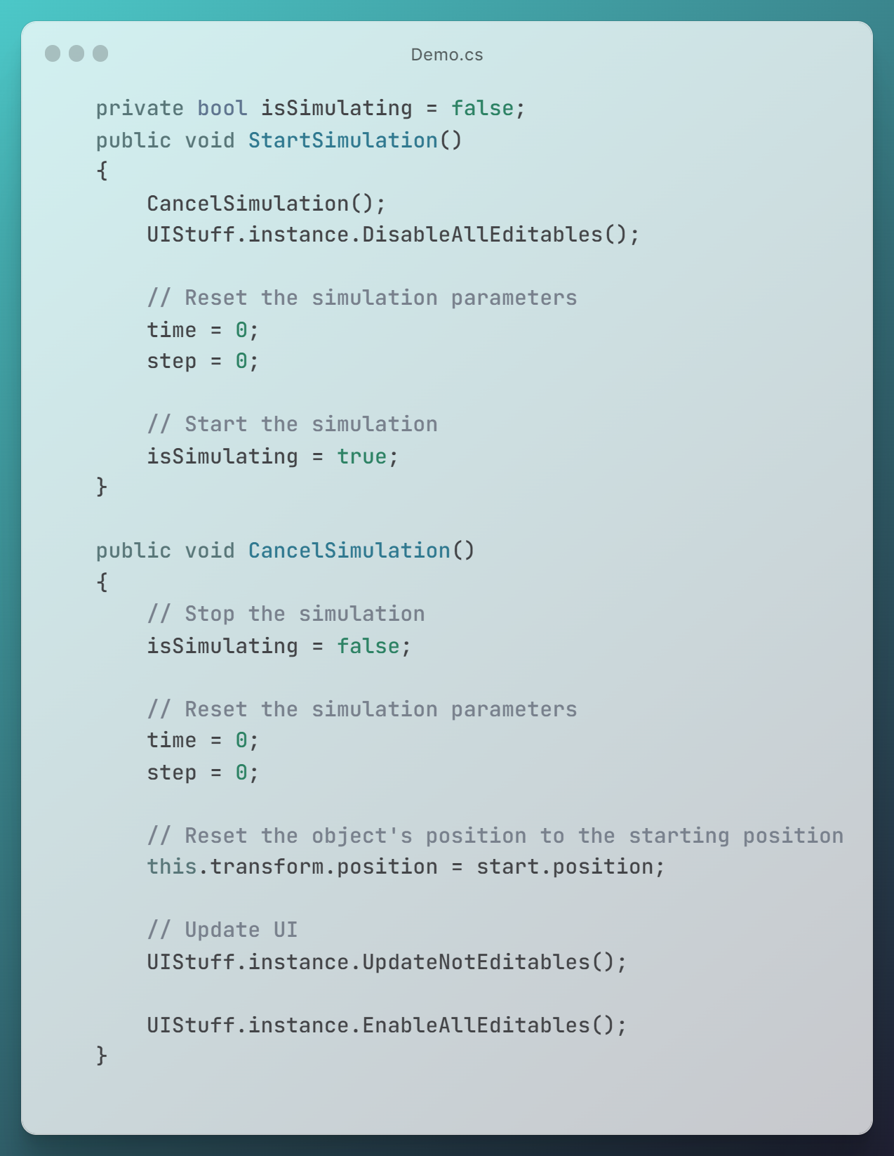
Projectile Motion:
What?
Why & Where?
Theory
Code (2)
?

Slide 17
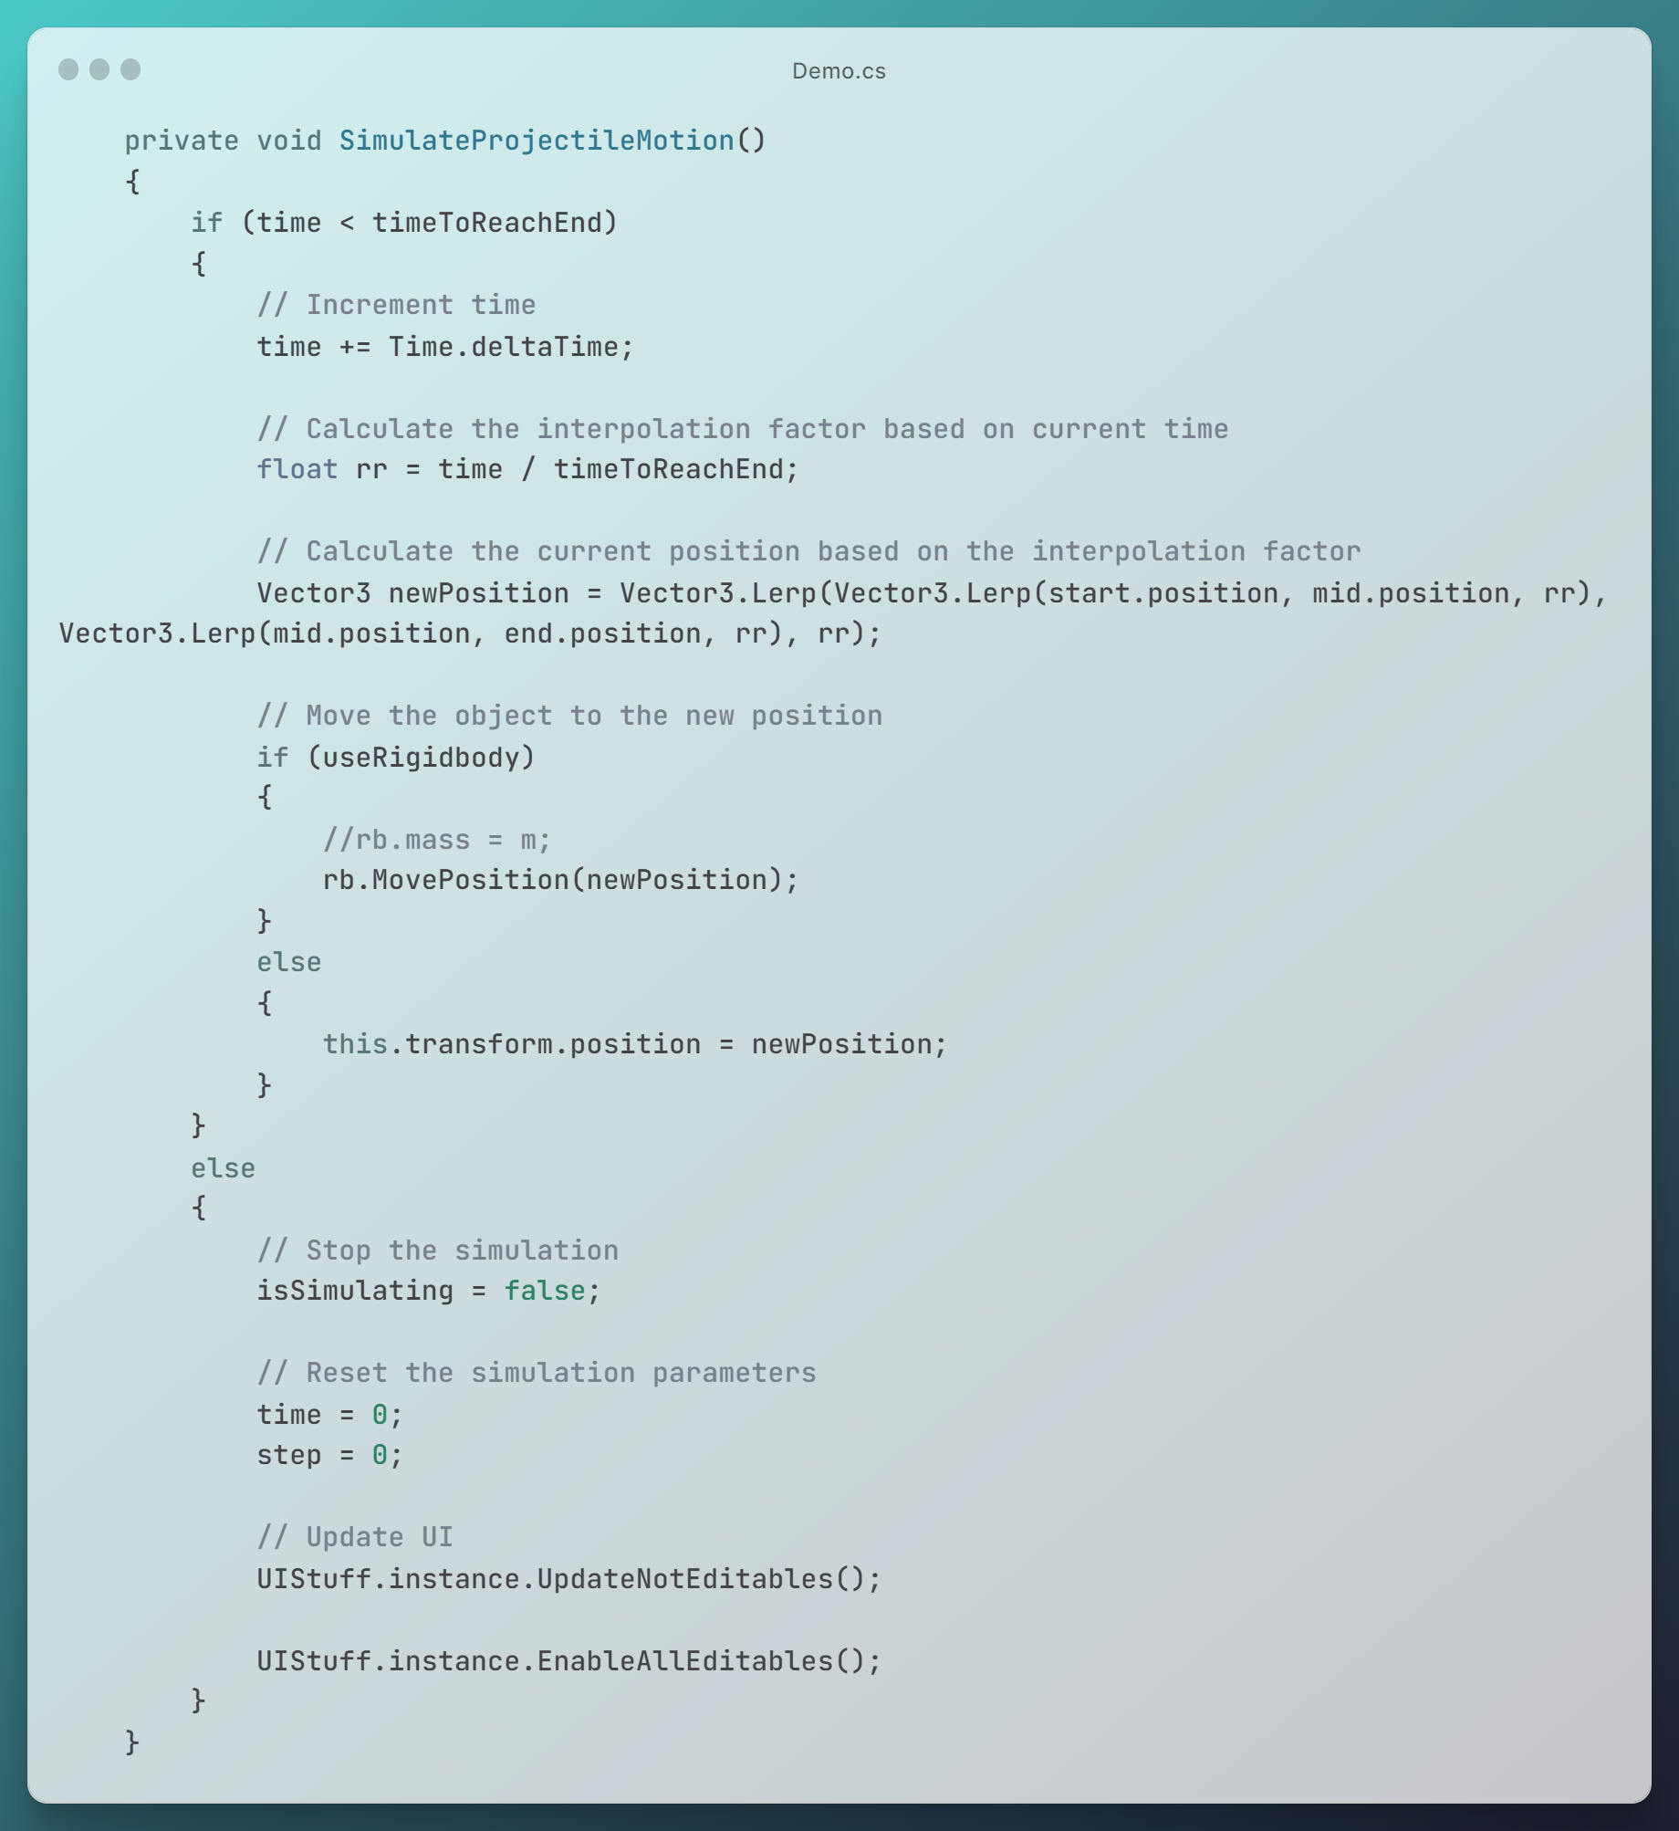
Projectile Motion:
What?
Why & Where?
Theory
Code (2)
?

Slide 18
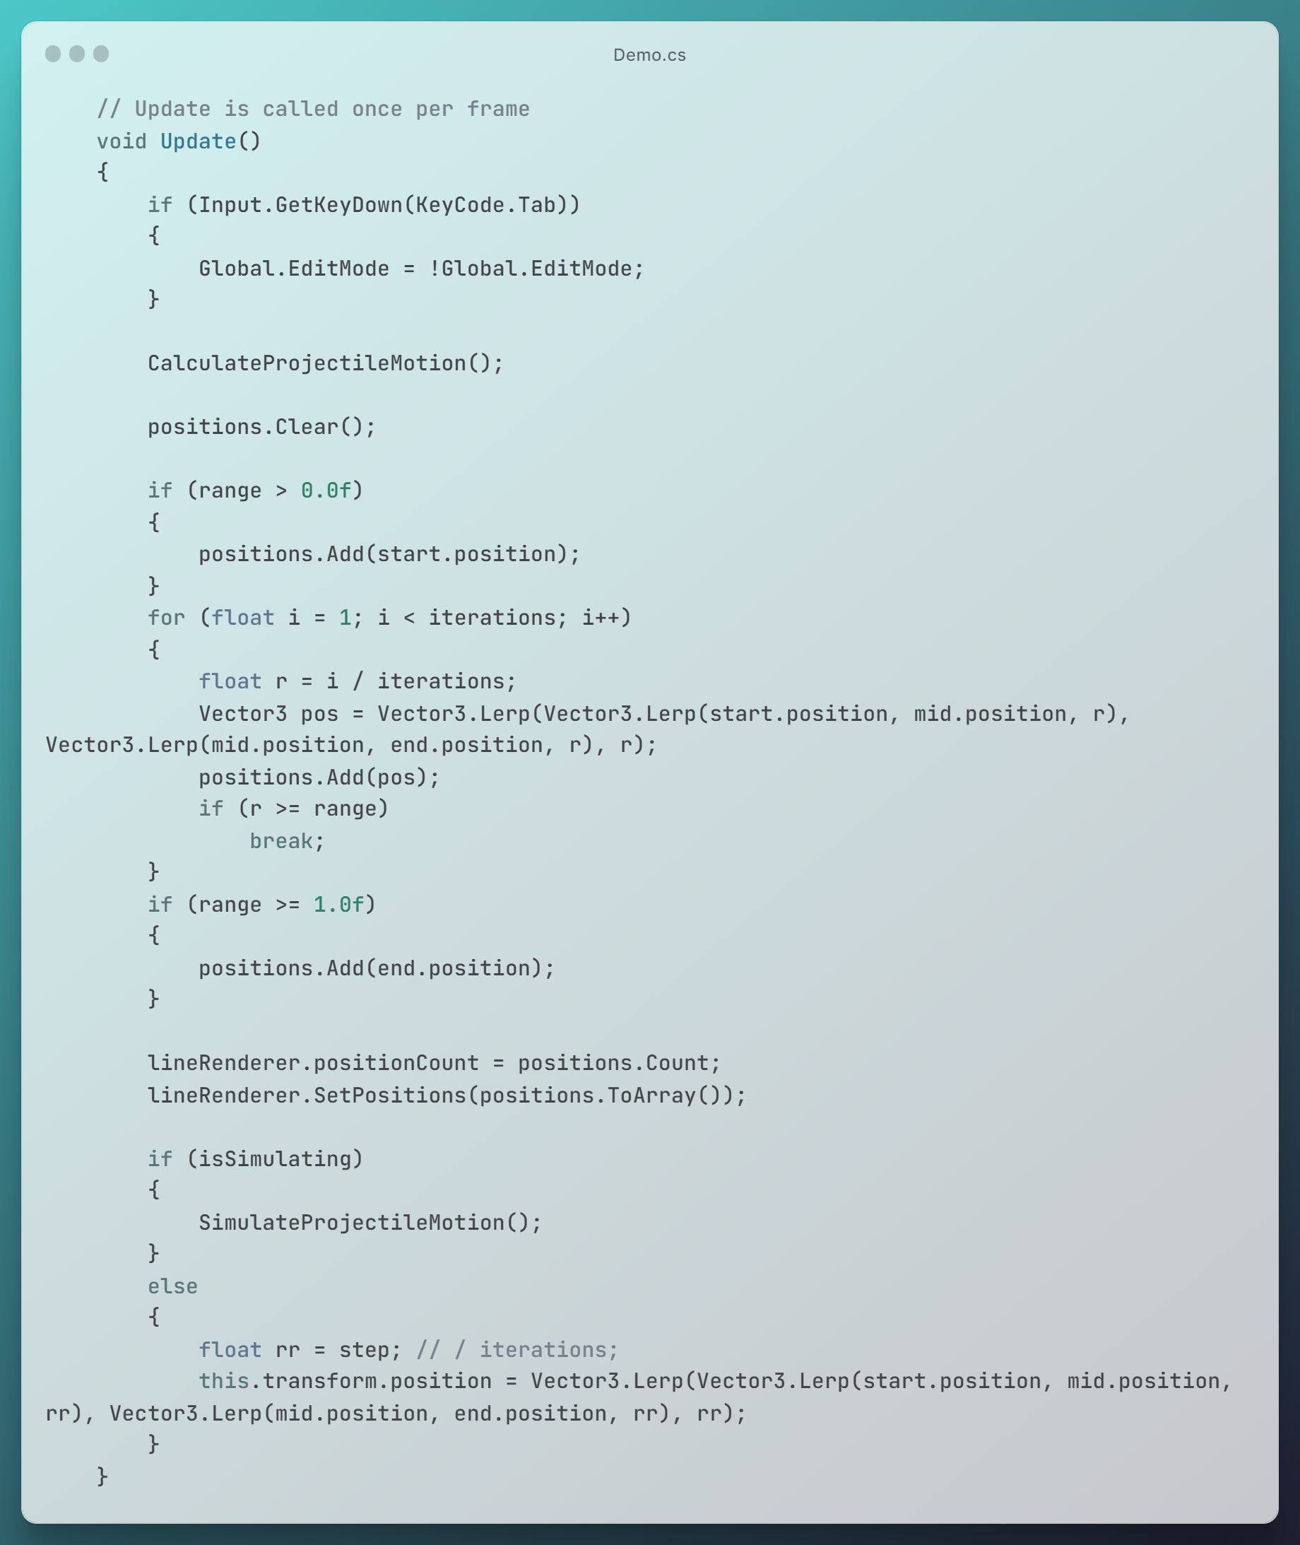
Projectile Motion:
What?
Why & Where?
Theory
Code (2)
?

Slide 19
Projectile Motion:
What?
Why & Where?
Theory
Code (3)
?
Linear Interpolation (LERP)?

Slide 20
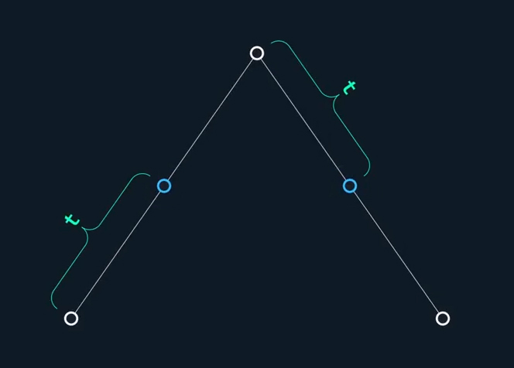
Projectile Motion:
What?
Why & Where?
Theory
Code (4)
?
Bezier Curve (Quadratic)?

Slide 21
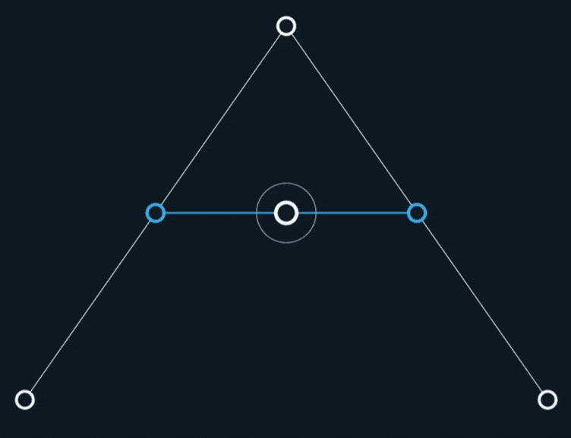
Projectile Motion:
What?
Why & Where?
Theory
Code (5)
?
Bezier Curve (Quadratic)?

Slide 22
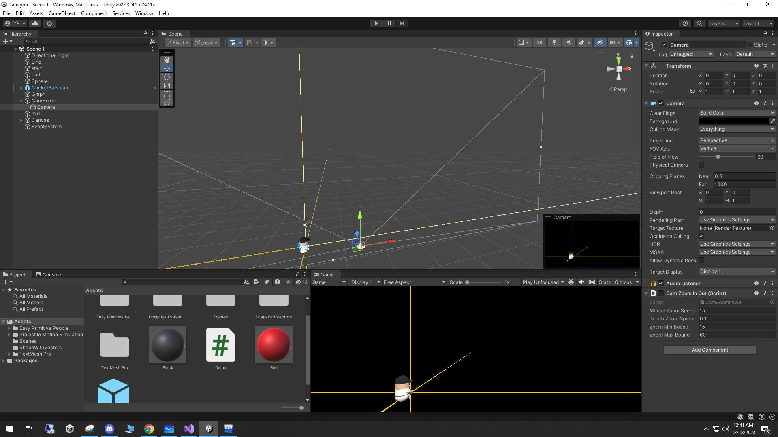
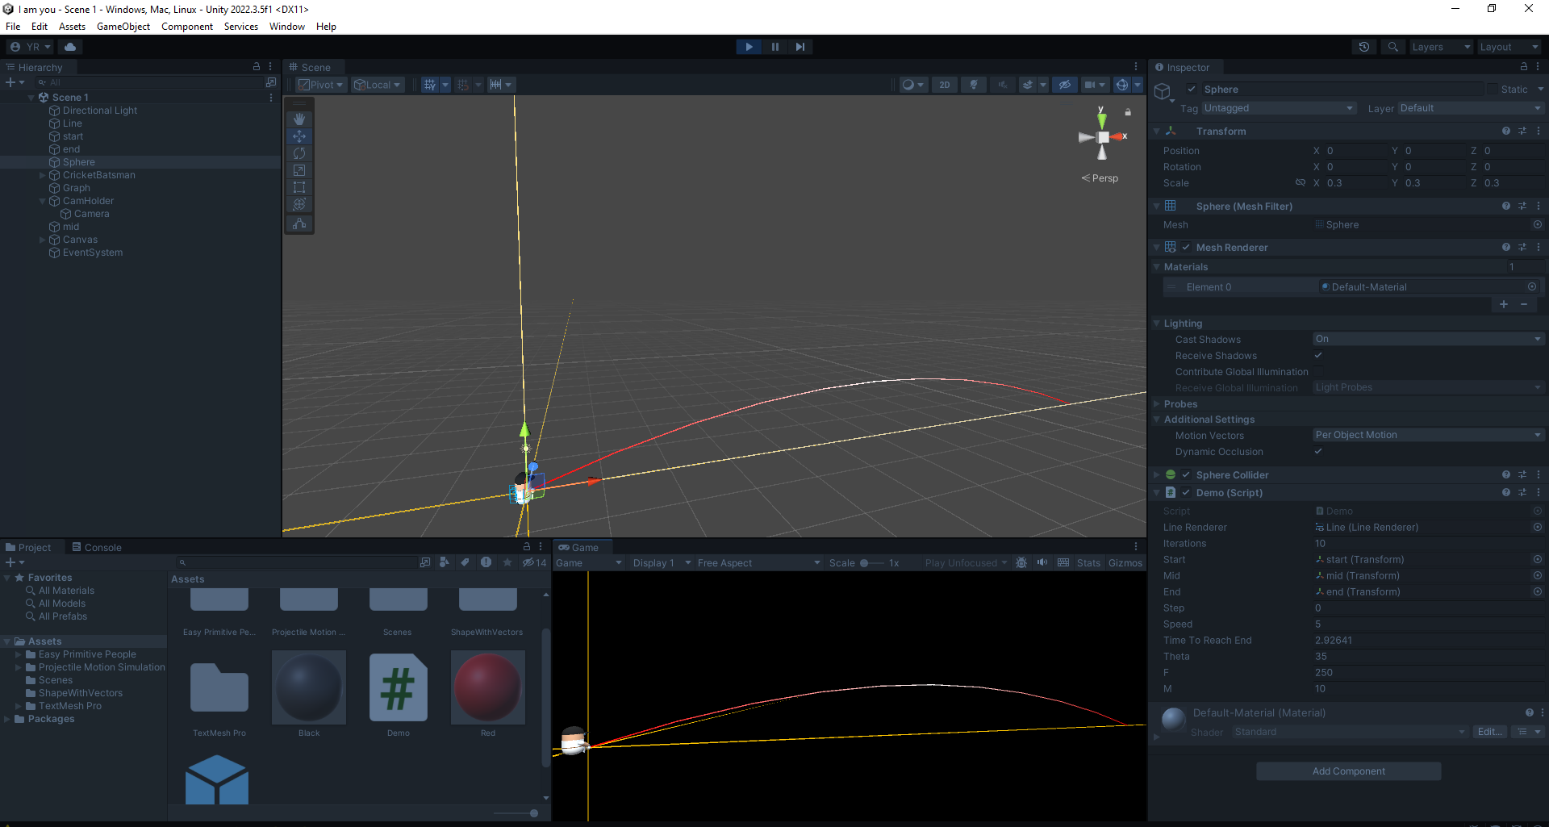
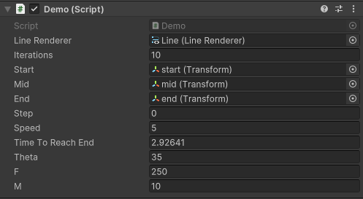
Projectile Motion:
What?
Why & Where?
Theory
Code
Demo

Slide 23
Thank You!
Any Questions?

